Slide 1
Lect-13 Vertex Cover
Hizbullah Khattak

Slide 2
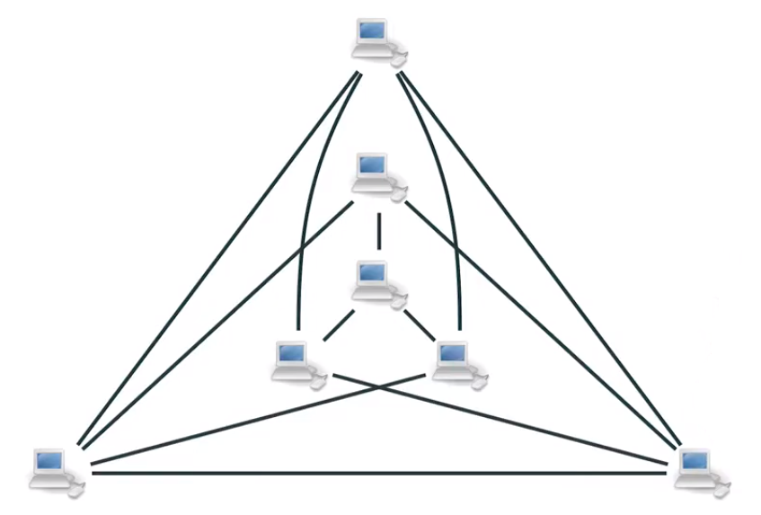
Antivirus System

Slide 3
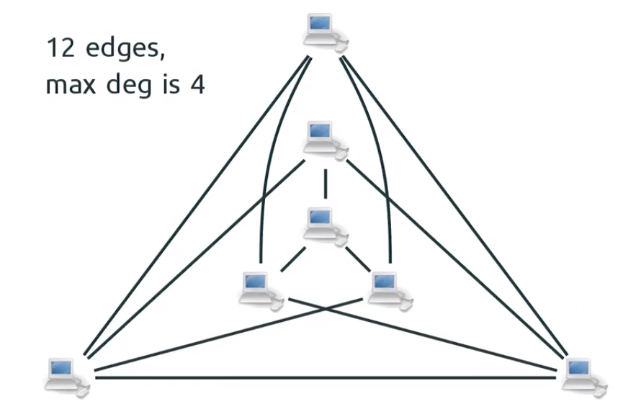
Antivirus System

Slide 4
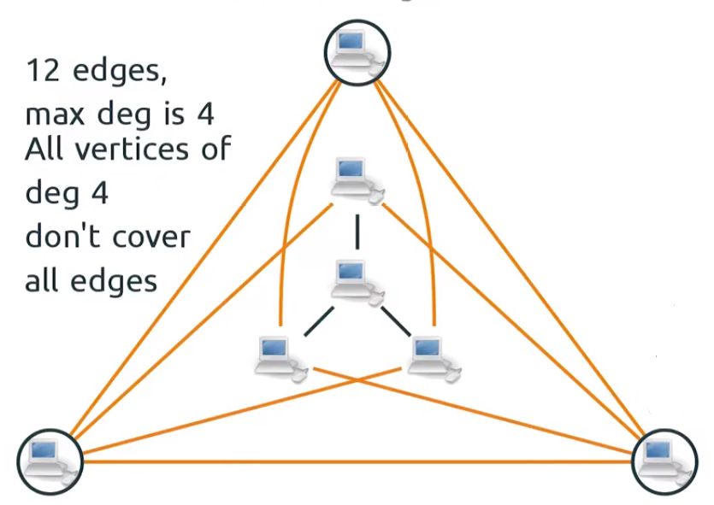
Antivirus System

Slide 5
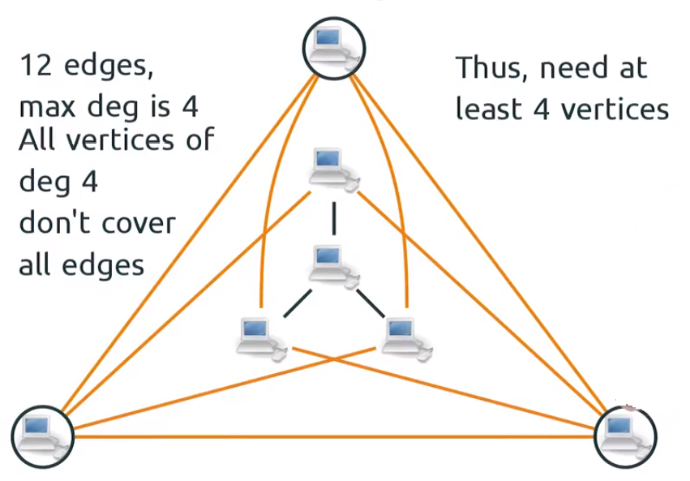
Antivirus System

Slide 6
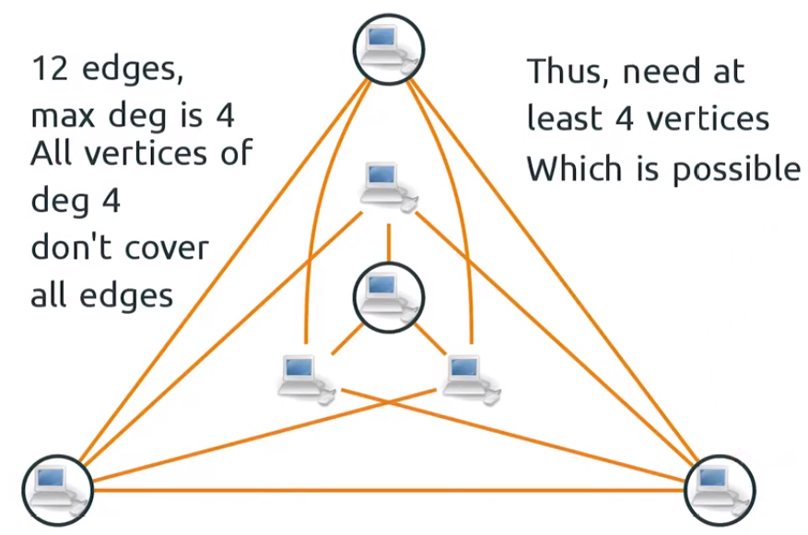
Antivirus System

Slide 7
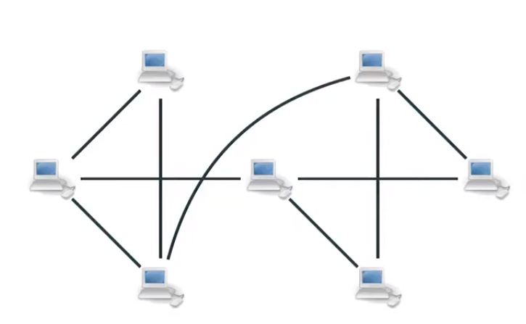
Antivirus System

Slide 8
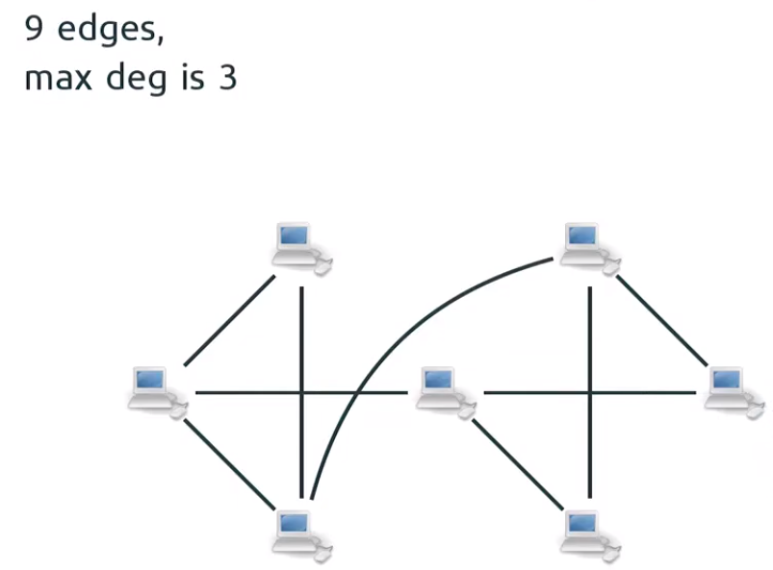
Antivirus System

Slide 9
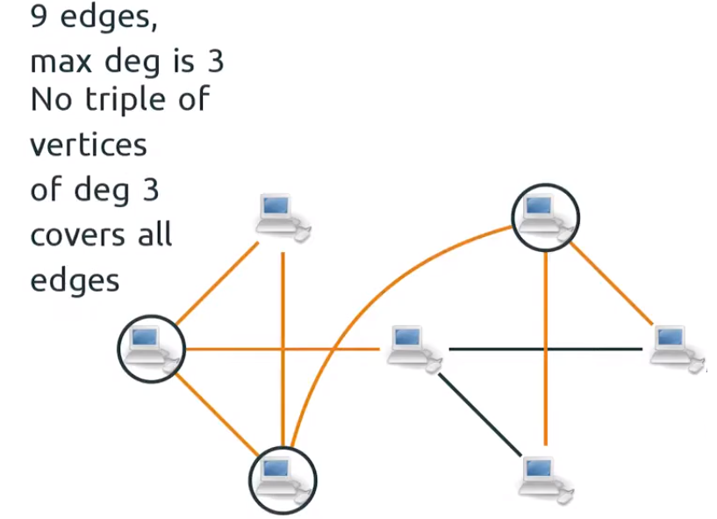
Antivirus System

Slide 10
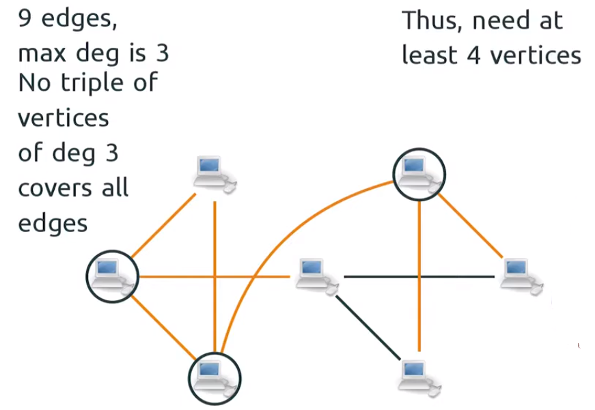
Antivirus System

Slide 11
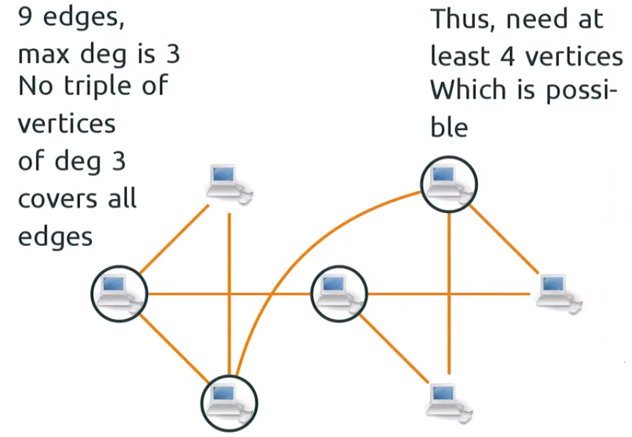
Antivirus System

Slide 12
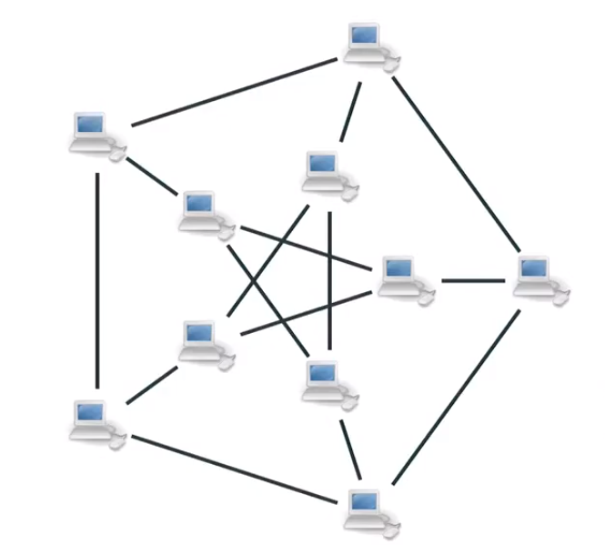
Antivirus System

Slide 13
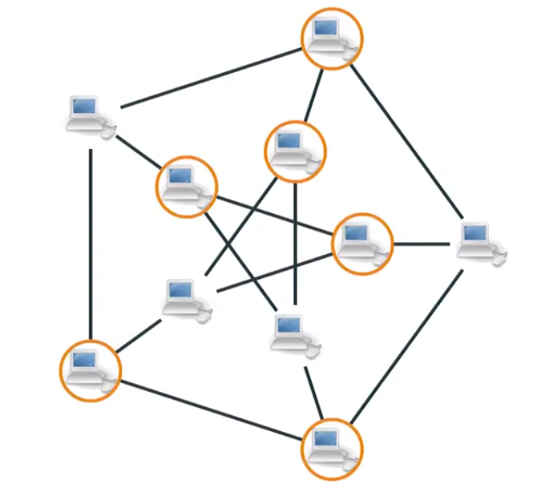
Antivirus System

Slide 14
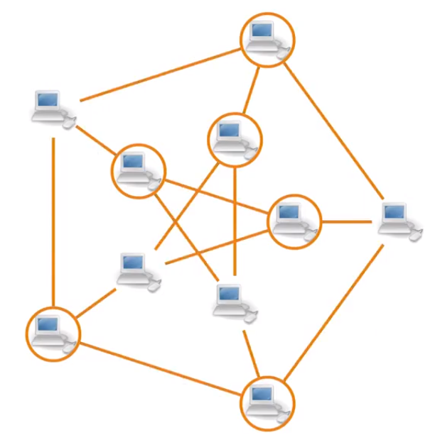
Antivirus System

Slide 15
Vertex Covers

Slide 16
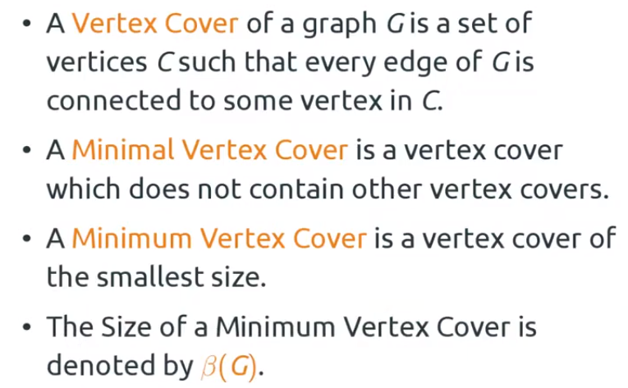
Vertex Covers

Slide 17
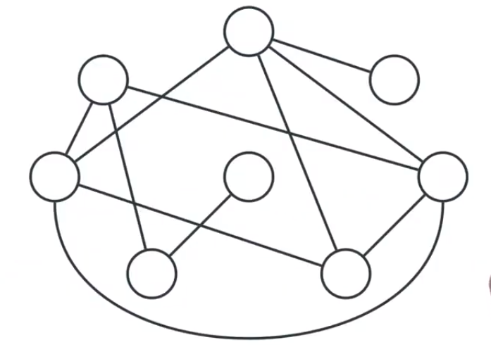
Vertex Covers: Examples

Slide 18
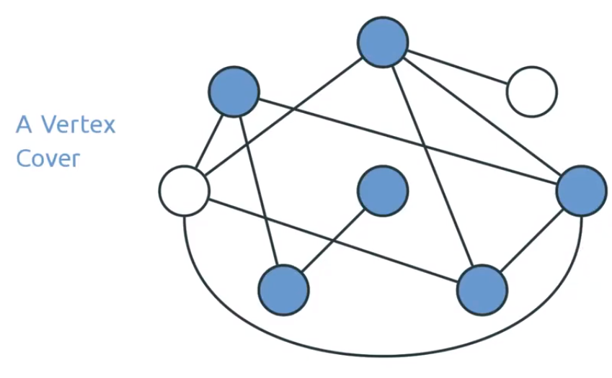
Vertex Covers: Examples

Slide 19
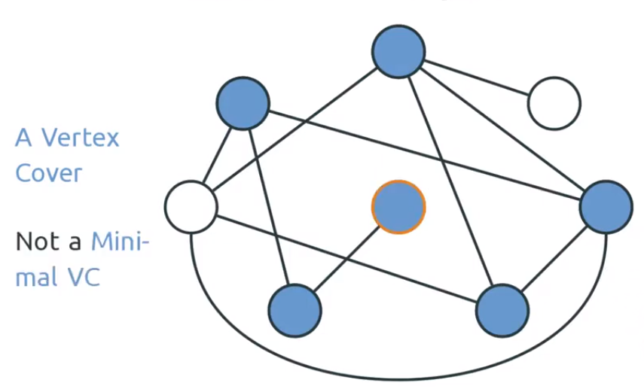
Vertex Covers: Examples

Slide 20
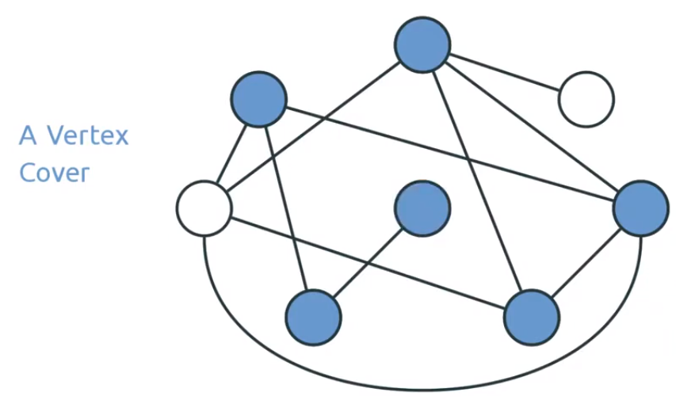
Vertex Covers: Examples

Slide 21
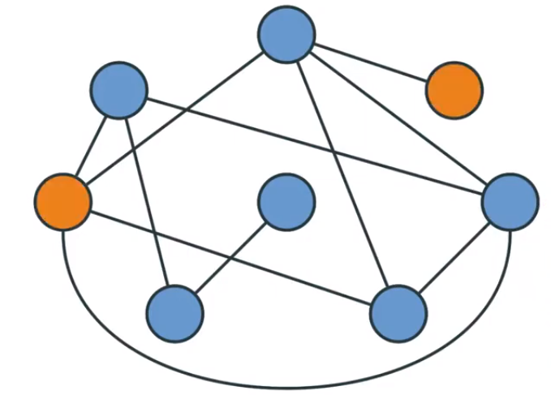
Vertex Covers: Examples

Slide 22
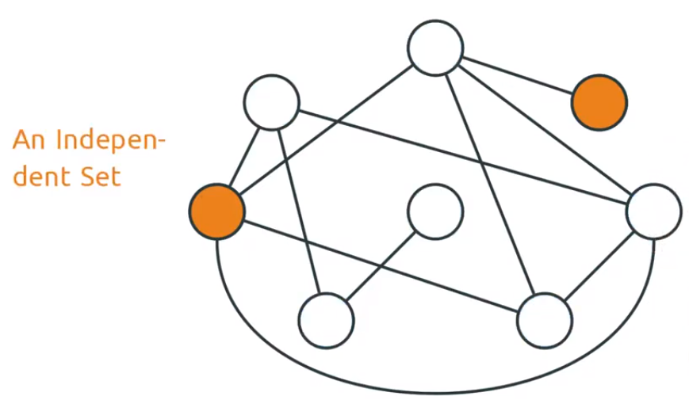
Vertex Covers: Examples

Slide 23
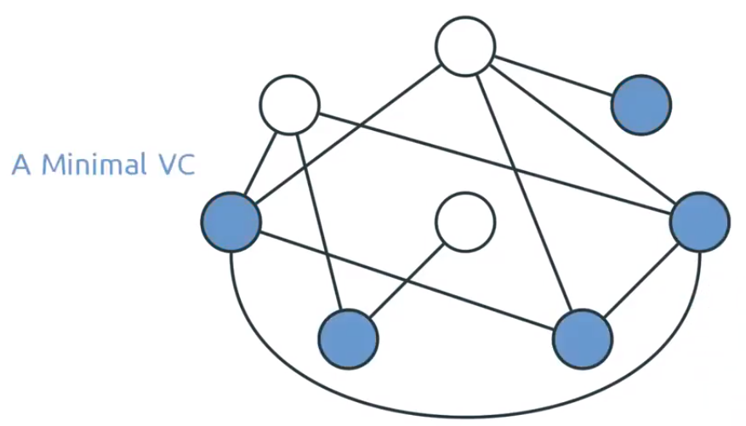
Vertex Covers: Examples

Slide 24
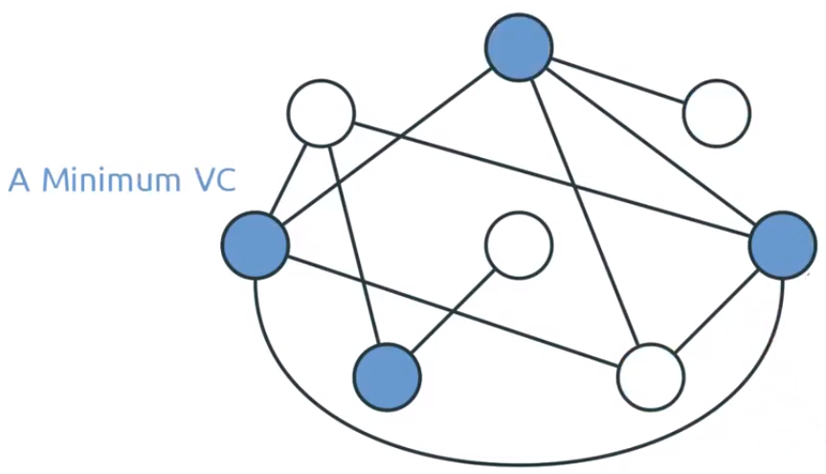
Vertex Covers: Examples

Slide 25
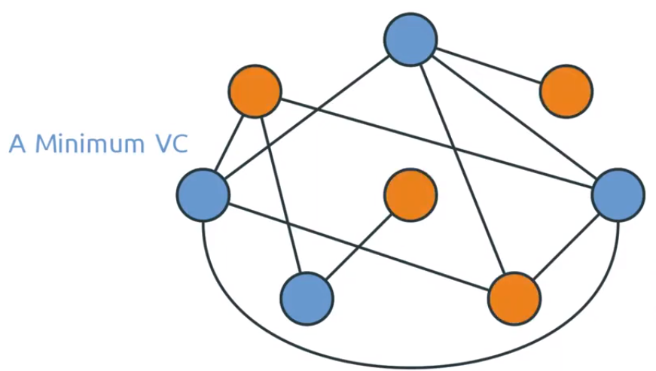
Vertex Covers: Examples

Slide 26
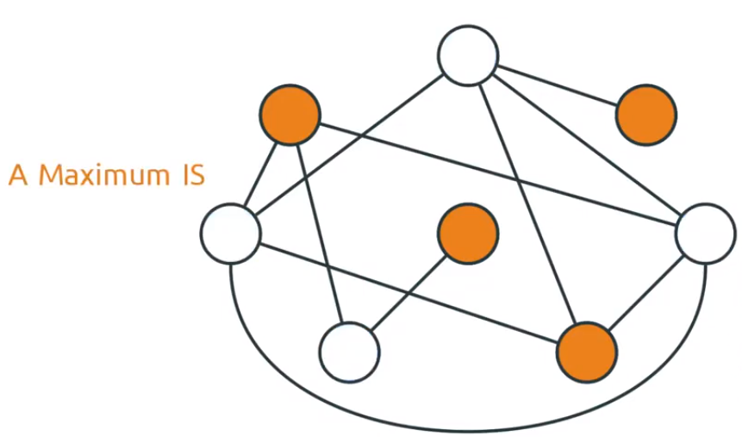
Vertex Covers: Examples

Slide 27
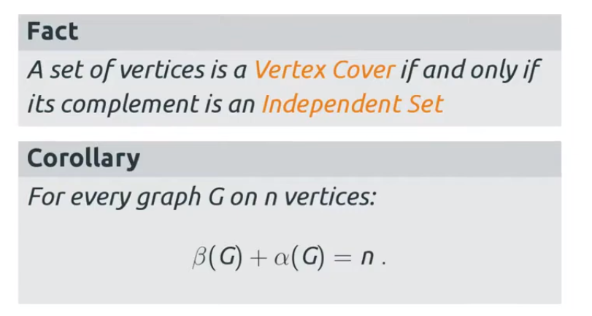
Vertex Covers and IS’s

Slide 28
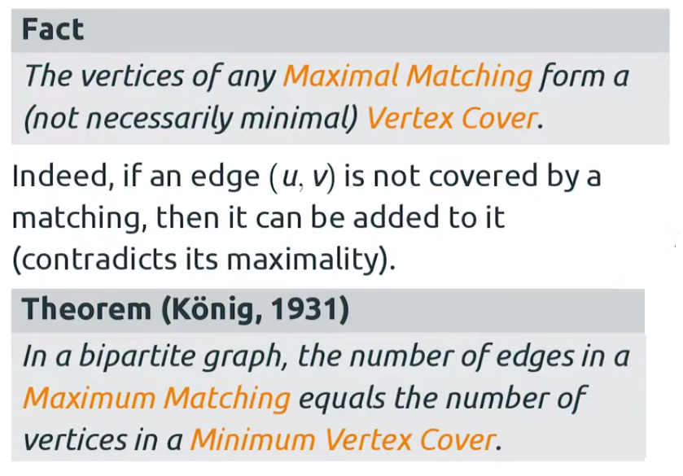
Konig’s Theorem

Slide 29
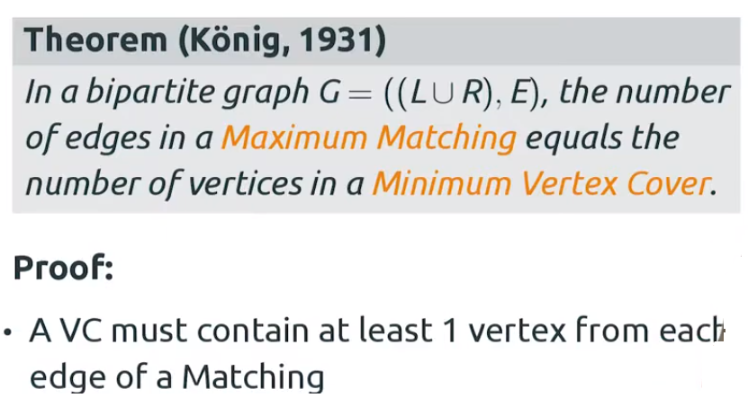
Konig’s Theorem. Proof

Slide 30
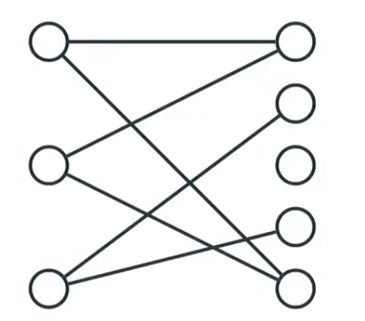
Konig’s Theorem. Proof

Slide 31
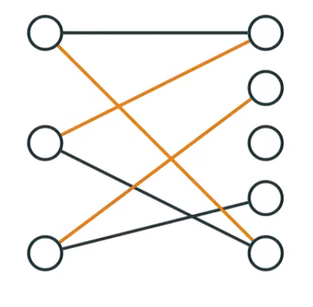
Konig’s Theorem. Proof

Slide 32
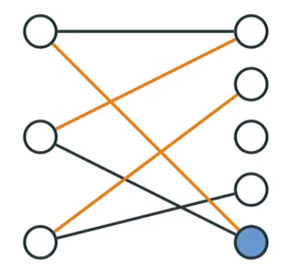
Konig’s Theorem. Proof

Slide 33
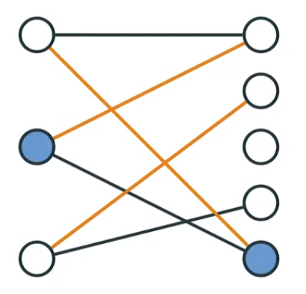
Konig’s Theorem. Proof

Slide 34
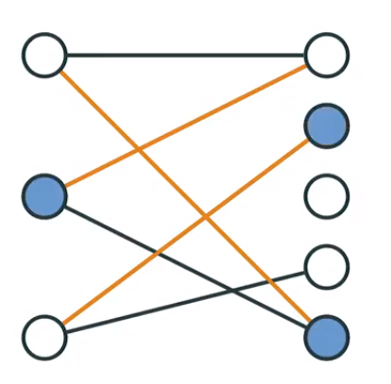
Konig’s Theorem. Proof

Slide 35
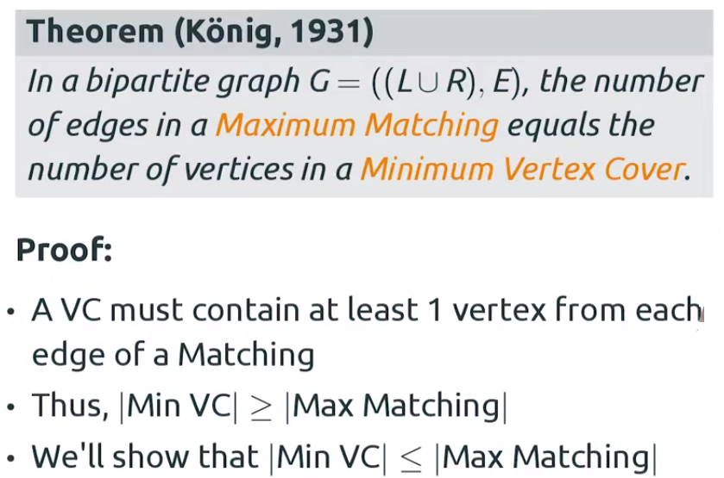
Konig’s Theorem. Proof

Slide 36
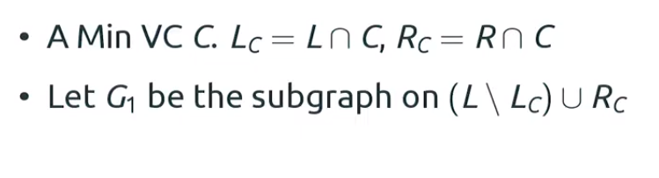
Konig’s Theorem from Hall’s Theorem

Slide 37
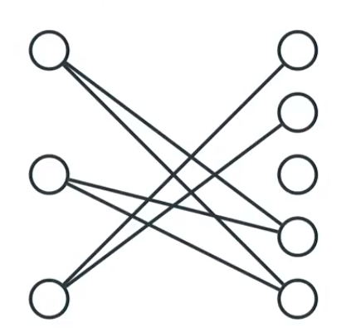
Konig’s Theorem from Hall’s Theorem

Slide 38
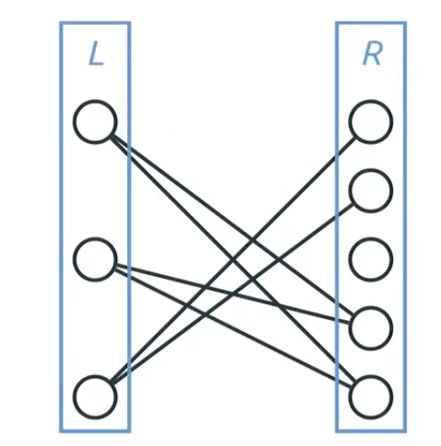
Konig’s Theorem from Hall’s Theorem

Slide 39
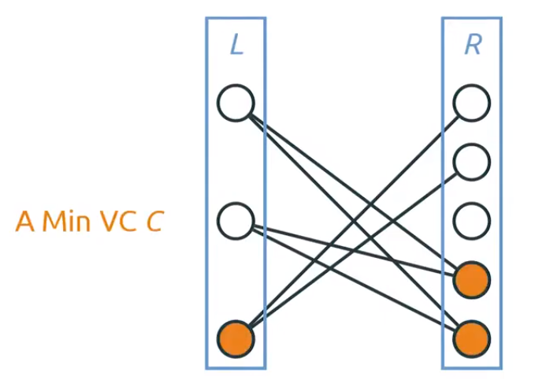
Konig’s Theorem from Hall’s Theorem

Slide 40
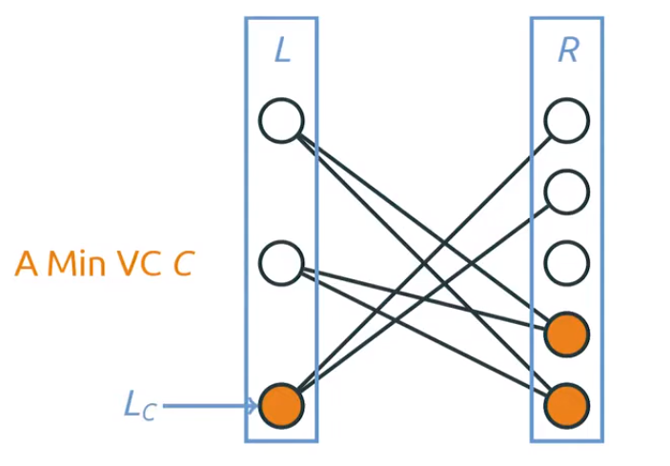
Konig’s Theorem from Hall’s Theorem

Slide 41
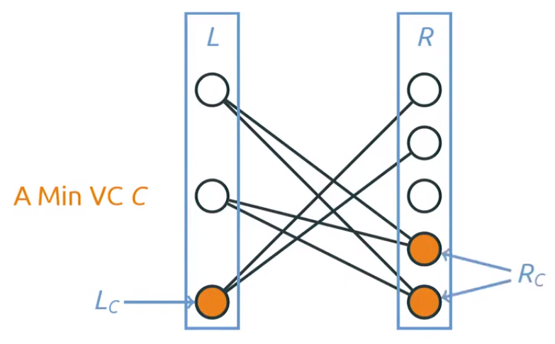
Konig’s Theorem from Hall’s Theorem

Slide 42
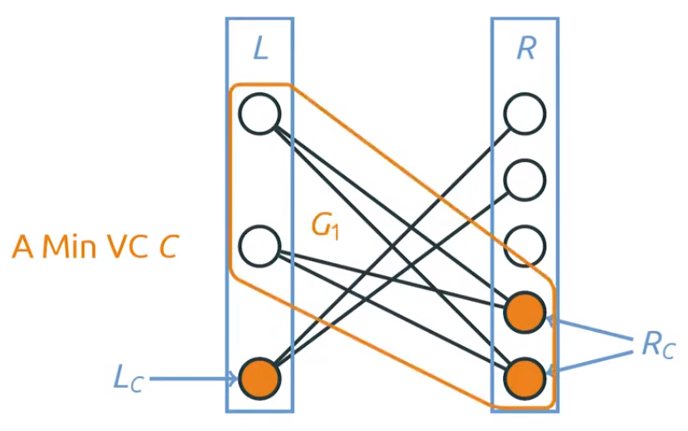
Konig’s Theorem from Hall’s Theorem

Slide 43
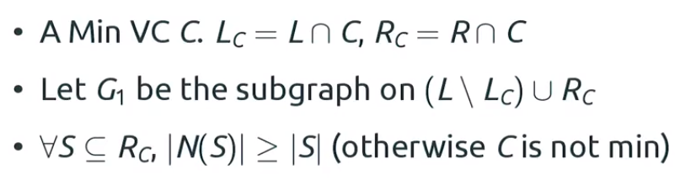
Konig’s Theorem from Hall’s Theorem

Slide 44
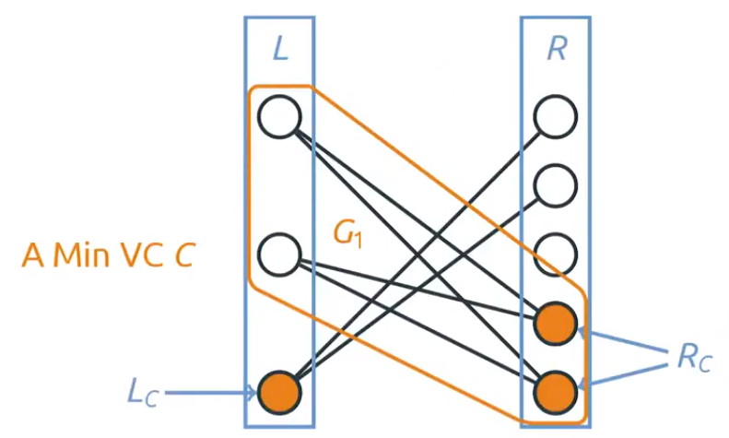
Konig’s Theorem from Hall’s Theorem

Slide 45
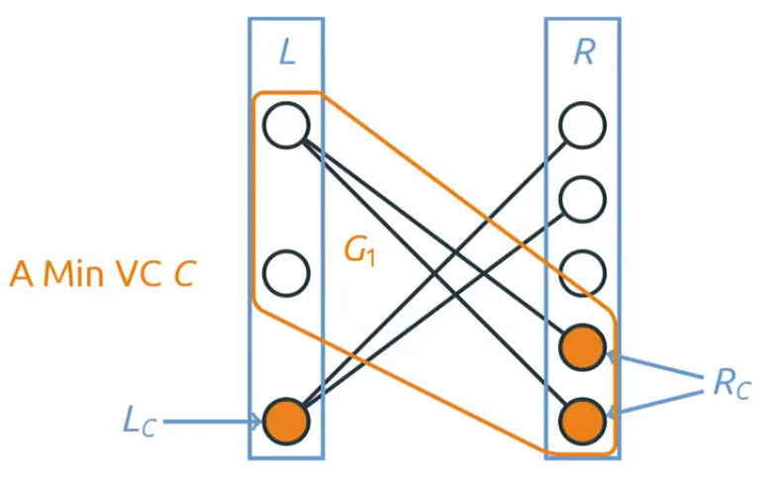
Konig’s Theorem from Hall’s Theorem

Slide 46
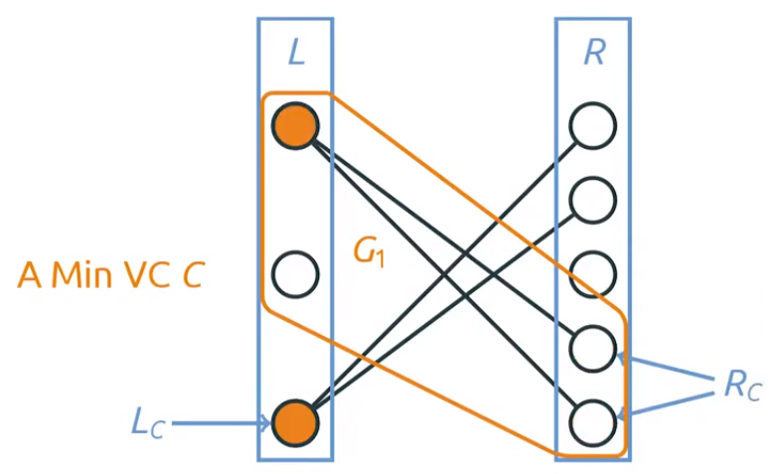
Konig’s Theorem from Hall’s Theorem

Slide 47
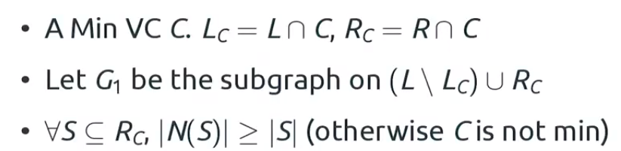
Konig’s Theorem from Hall’s Theorem

Slide 48
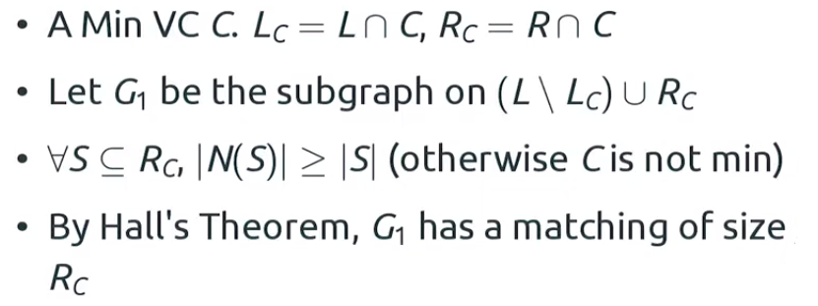
Konig’s Theorem from Hall’s Theorem

Slide 49
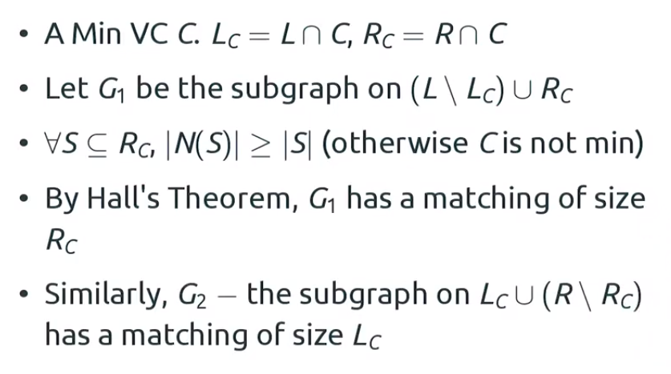
Konig’s Theorem from Hall’s Theorem

Slide 50
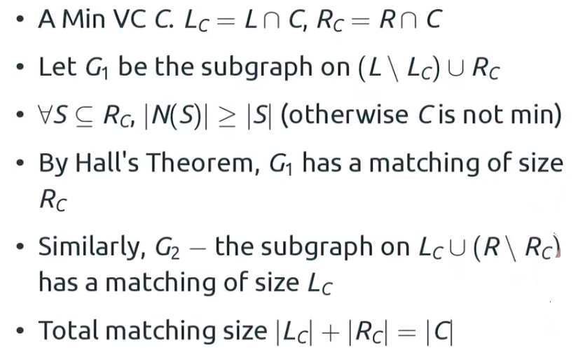
Konig’s Theorem from Hall’s Theorem

